Slide 1


Customer Retention & Dynamic Pricing Analysis
Data-Driven Revenue Risk Mitigation for Hotel Operations

Slide 2
High Cancellation Rates Are Bleeding Revenue
The hotel faces a significant financial risk due to late-stage cancellations. This project isolates the root causes of customer churn and proposes actionable deposit and inventory strategies to protect revenue without sacrificing booking volume.

Slide 3
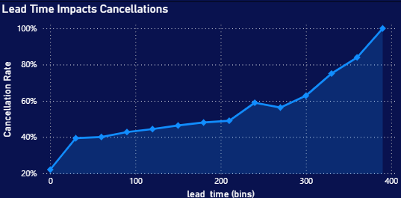

OTAs & Early Bookings Drive Highest Churn
The OTA Problem: Online Travel Agencies (Booking.com, Expedia) heavily incentivize "free cancellations," shifting the operational and financial risk entirely to the hotel.
The Lead Time Risk: Bookings made 60+ days in advance act as low-commitment "placeholder" reservations. As lead time increases, the probability of cancellation rises exponentially.

Slide 4
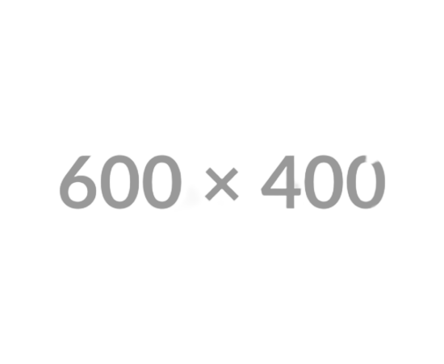
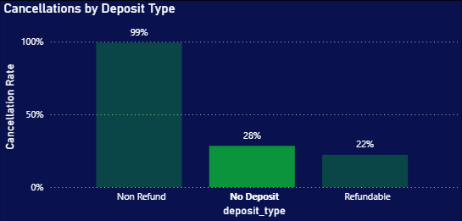
Financial Commitment Reduces Risk
Zero Friction, High Risk: "No Deposit" bookings account for nearly all of the cancellation weight across our historical dataset.
Secured Revenue: Applying a "Non-Refundable" policy drops the cancellation rate to near zero. We are currently offering maximum flexibility with zero downside for the customer.

Slide 5






Data-Driven Solutions to Protect Revenue
Dynamic Deposits
OTA Reallocation
Predictive Overbooking
Implement a Time-Based Rule: Require a 20% non-refundable deposit for bookings made 60+ days in advance, while maintaining "no deposit" flexibility for short-notice bookings to preserve conversion rates.
Cap the room inventory allocated to high-churn OTA channels during peak high-demand seasons. Shift this inventory toward Direct and Corporate bookings where retention is statistically stable.
Utilize our newly developed Machine Learning probabilities to safely overbook specific high-churn room types. This maximizes occupancy and offsets anticipated cancellations without risking "walked" guests.

Slide 6
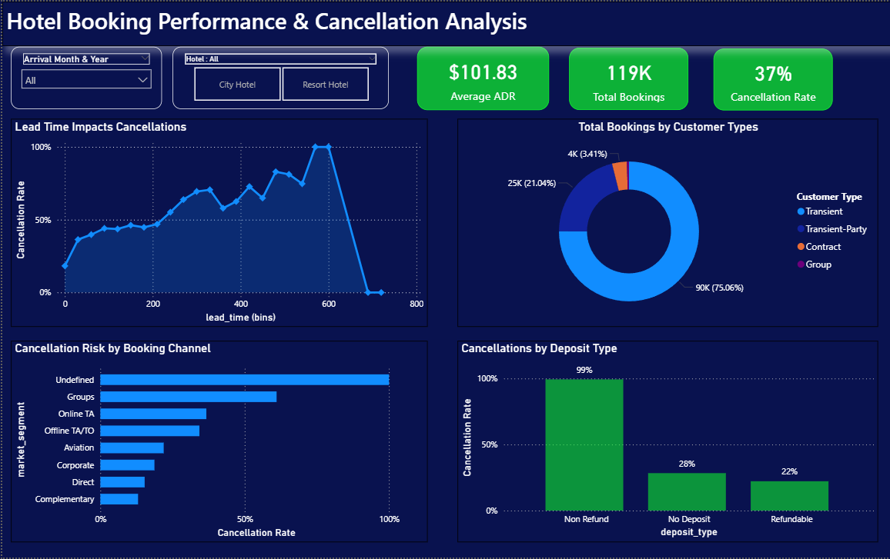
Dashboard

